Slide 1
PROJECT: BLOOD BANK MANAGEMENT SYSTEM Course Code: CSE 212 Course Title: Object Oriented Programming Sessional
Submitted By-
JOYJIT PAUL(CSE 021 07062)
SUMON DAS(CSE 021 07058)
JIJANUR RAHMAN(CSE 021 07076)
Submitted To-
Md. Muhtadir Rahman,
Department of Computer Science & Engineering

Slide 2
CONTENTS
Problem statement
Problem objectives
Project scope
System architecture
Project stakeholders
Use case diagram
Activity diagram
User interface(UI)
Cost analysis
Applicability
Thank you page
Q&A

Slide 3
PROBLEM STATEMENT
At present, the public can only know about the blood donation events through conventional media means such as radio, news paper or television advertisements. There is no information regarding the blood donation programs available on any of the portal.
The current system that is using by the blood bank is manual system. With the manual system, there are problems in managing the donors' records. The records of the donor might not be kept safely and there might be missing of donor's records due to human error or disasters. Besides that, errors might occur when the staff keeps more than one record for the same donor.
There is no centralized database of volunteer donors. So, it becomes really tedious for a person to search blood in case of emergency. The only option is to manually search and match donors and then make phone calls to every donor.
There is also no centralized database used to keep the donors' records. Each bank is having their own records of donors. If a donor makes donation in different hospital, no previous records can be traced except if the donor brings along the donation certificate. Hence, the donor is considered to be a first-timer if they make blood donation in a new place.
Without an automated management system, there are also problems in keeping track of the actual amount of each and every blood type in the blood bank. In addition, there is also no alert available when the blood quantity is below its par level or when the blood in the bank has expired.

Slide 4
PROBLEM OBJECTIVES
The objectives of the Blood Bank Management System are as follows:
1. To provide a means for the blood bank to publicize and advertise blood donation programs.
2. To allow the probable recipients to make search and match the volunteer donors, and make request for the blood.
3. To provide an efficient donor and blood stock management functions to the blood bank by recording the donor and blood details.
4. To improve the efficiency of blood stock management by alerting the blood bank staffs when the blood quantity is below it par level or when the blood stock has expired.
5. To provide synchronized and centralized donor and blood stock database.
6. To provide immediate storage and retrieval of data and information.

Slide 5
PROJECT SCOPE
The system is used for maintaining all the process and activities of blood bank management system. The system can be extended to be used for maintaining records of hospital, organ donation and other similar sectors. While developing the system, there shall be space for further modification. There shall be a proper documentation so that further enhancement becomes easy. As a whole the system is focused to work with blood bank management system and on additional modification it can be also used as management systems of similar organizations.

Slide 6
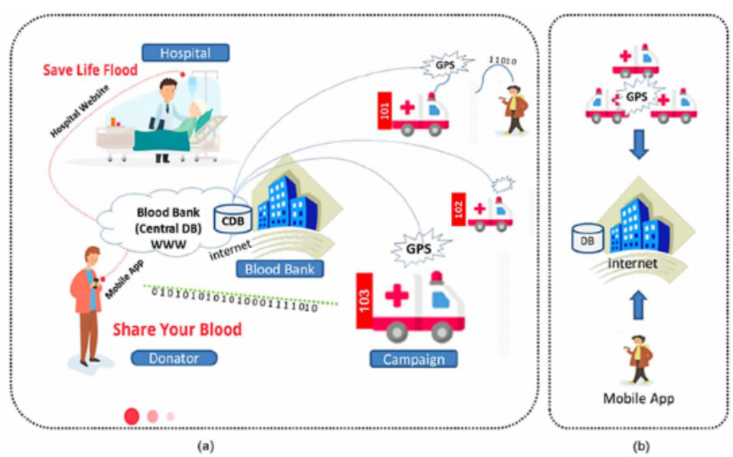
SYSTEM ARCHITECTURE

Slide 7
PROJECT STAKEHOLDERS
1) System Owner: The Blood Bank
2) System Users:
• Administrators: has full privilege on the system's functions
• Staffs of Blood Bank: has privilege on the system's functions as assigned by the administrator
• Public: can view the blood donation events and donate or can make requests for donation (Donor and Recipients fall under this category)

Slide 8
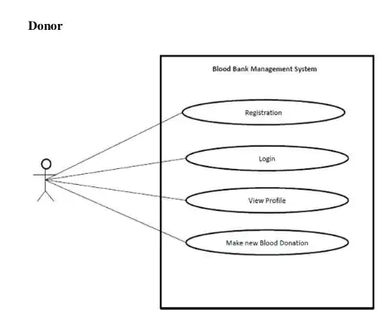
USE CASE DIAGRAM

Slide 9
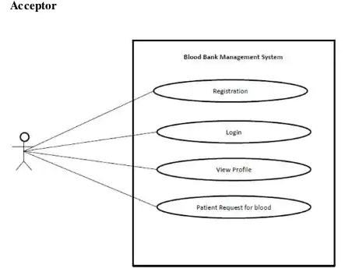
USE CASE DIAGRAM

Slide 10
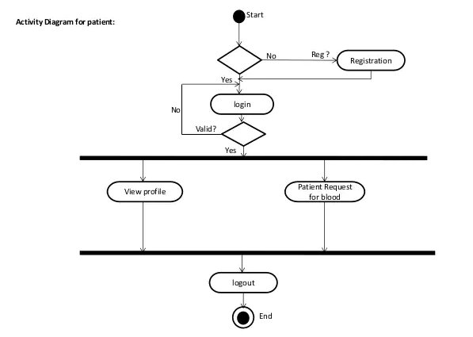
ACTIVITY DIAGRAM

Slide 11
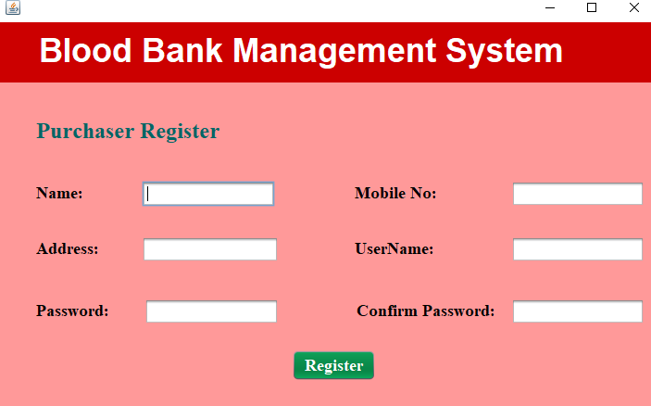
USER INTERFACE
This is Donor Register page

Slide 12
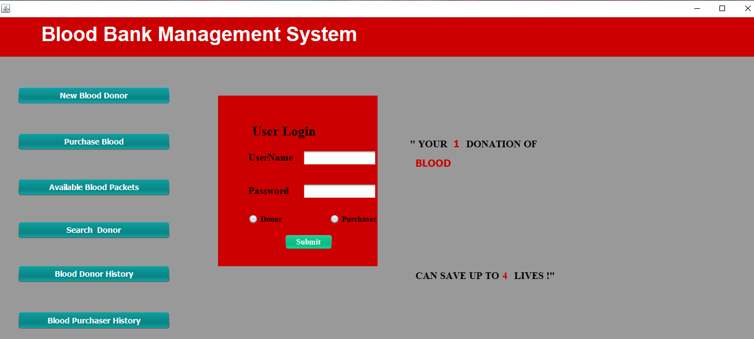
USER INTERFACE
This is User Login page

Slide 13
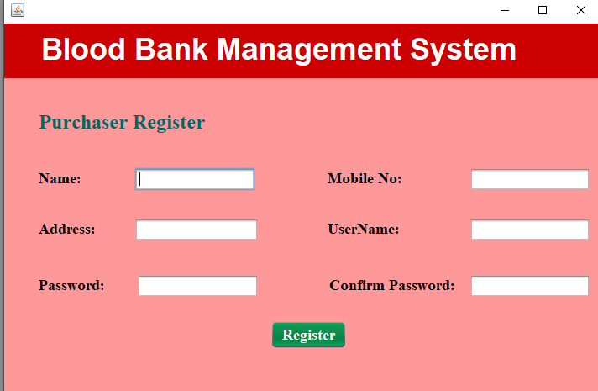
USER INTERFACE
This is Purchaser Register page

Slide 14
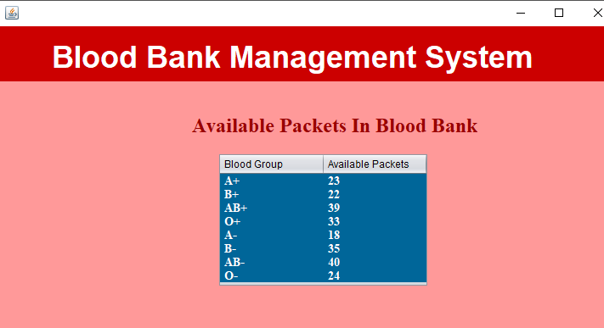
USER INTERFACE
This is Available Packet page

Slide 15
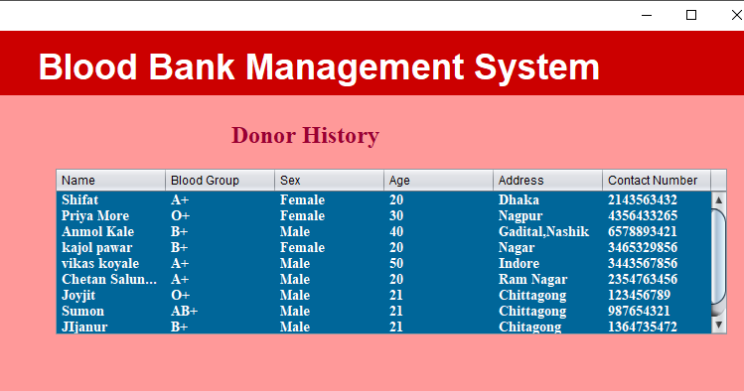
USER INTERFACE
This is Search Donor page

Slide 16
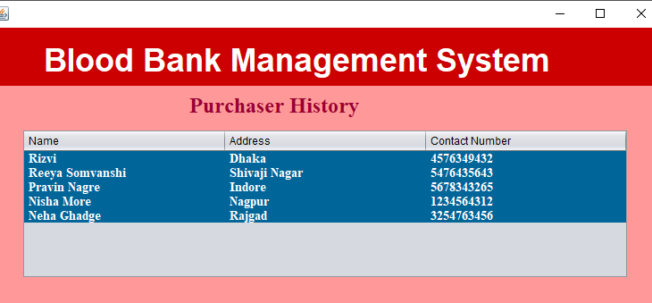
USER INTERFACE
This is Purchaser History Page

Slide 17
COST ANALYSIS
• Server BDT: 20,000
• Domain name BDT:16,000/year
• WLAN BDT:20,000
• sms gateway BDT: 100,000
• Research Budget BDT:40,000
• Coding Budget BDT:150,000
• Miscellaneous BDT:4000
• Total------------------------------ BDT:350,000

Slide 18
APPLICABILITY
Blood banks play an important role in the process of collecting blood and managing blood stocks, approving blood requests, updating donations and updating available blood types.

Slide 19
THANK YOU

Slide 20
Q&A

